Slide 1
Introduction to developing with Power Platform
Notes:
Reference https://docs.microsoft.com/en-us/learn/paths/intro-developing-power-platform/

Slide 2
What is Microsoft Dataverse?
Note
Effective November 2020:
Common Data Service has been renamed to Microsoft Dataverse. Learn more
Some terminology in Microsoft Dataverse has been updated. For example, entity is now table and field is now column. Learn more

Slide 3
Agenda
Introduction to Power Platform developer resources
Use developer tools to extend the Power Platform
Introduction to extending the Microsoft Power Platform

Slide 4

Introduction to Power Platform developer resources

Slide 5
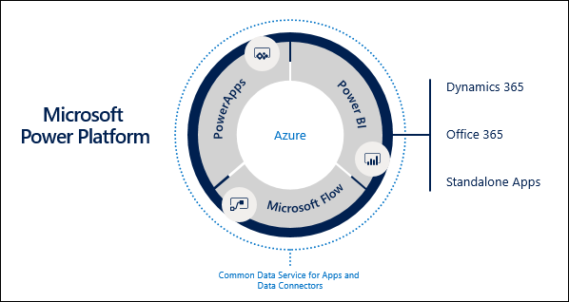
Microsoft Power Platform overview
The Microsoft Power Platform encompasses the entire suite of Microsoft's business application products.
Notes:
The Microsoft Power Platform encompasses the entire suite of Microsoft's business application products. It includes three main components: Power BI, Power Automate, and Power Apps. Each component is designed to interact with the others to achieve business objectives, be it analytics, process automation, or building data-driven productivity applications. Developers are able to take advantage of the Power Platform as a low-code framework to build robust applications and extend upon each with custom code whenever the existing framework doesn't support the desired functionality. This approach to low-code development is a transformative way to quickly achieve application development objectives within an organization.
While future units of this module will mainly be focused on Power Apps, it is important for you to know the capabilities of Power BI and Power Automate in the context of our ecosystem because they play a relevant role to building model-driven Power Apps.
Common Data Service is a composite set of capabilities that can be used to build robust business applications. These capabilities include a cloud-scale entity framework and data store, business rules, workflows, dynamically-calculated fields, and many other capabilities. Common Data Service drives model-driven Power Apps, the primary focus in this learning path.
The Common Data Model is an open-sourced standard definition of entities that represent commonly used concepts and activities. When built in conjunction with a Common Data Service application, a core set of entities are provided upon which application builders can add their own custom entities to support specific business scenarios.

Slide 6
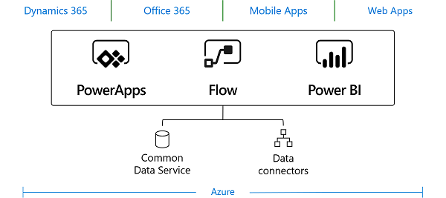
Common Data Service overview
Common Data Service is the newest generation of a longstanding application platform that is built by Microsoft and based on the proven Dynamics 365 Customer Engagement apps platform.
Notes:
Common Data Service is the newest generation of a longstanding application platform that is built by Microsoft and based on the proven Dynamics 365 Customer Engagement apps platform. The extensibility model is robust and can be used to build a wealth of low-code application solutions.
Common Data Service comes with a unified set of features that enable you to create business-focused definitions of your organization's data and business processes within a variety of applications. Because data and metadata are both stored in the cloud, applications are simple to manage and administer. Additionally, a built-in security model allows you to control access to entities and functionality for different sets of users within your organization.
Microsoft has already built several first-party applications on Common Data Service, including Dynamics 365 for Sales, Service, and Talent. By building all apps on top of the same Common Data Service platform, you can interact with data that is constructed by other applications within Common Data Service.

Slide 7
When to write code
As a PowerApp developer, you need to understand the gaps that exist between what can be accomplished through configuration versus code.
Notes:
As a PowerApp developer, you need to understand the gaps that exist between what can be accomplished through configuration versus code. Sometimes, existing features might not provide the functionality needed to meet a requirement, and Common Data Service provides a variety of points where developers can extend the common functionality by using code.
To identify gaps where features don't already exist, it's crucial that all Power Apps developers familiarize themselves with the capabilities of Common Data Service.

Slide 8

Types of extensibility
Extending the user experience of a model-driven PowerApp
Extending the Common Data Service platform
Notes:
Typically, any code-customization activities are referred to as "extending" a model-driven application. Therefore, if you notice terms like extensibility, it generally means code in terms of model-driven PowerApp development. Within the extensibility model, activities are grouped into two broader buckets: extending the user experience and extending the Common Data Service platform.
To extend the user experience of a model-driven PowerApp, you can use web resources. Model-driven Power Apps expose a JavaScript client API that allows you to interact with application pages.
Because TypeScript, which compiles down to JavaScript, is a recommended tooling to use in many scripting scenarios, both languages are generalized into the term of "client script." With client script, you can configure form event handlers in the same way that you would an HTML form element. You can also call script functions from within a command bar (ribbon) and can consume client script web resources from within HTML web resources.
HTML web resources are used to display custom presentation logic within a form when more advanced requirements exist that can't be achieved by using the standard out-of-the-box forms.
Extending the Common Data Service platform is required whenever some level of automation needs to occur that existing features do not exist to support the current activities. These types of extensibility points run as server-side code through an asset called a plug-in. Power Automate and other options enable asynchronous automation and logic, but they haven't been able to do everything that plug-ins currently do in terms of synchronous rules. When requirements for synchronous operations exist within a model-driven application, plug-ins are still required.
Plug-in development is an essential skill and one of the most common tasks that is required of a PowerApp developer.

Slide 9
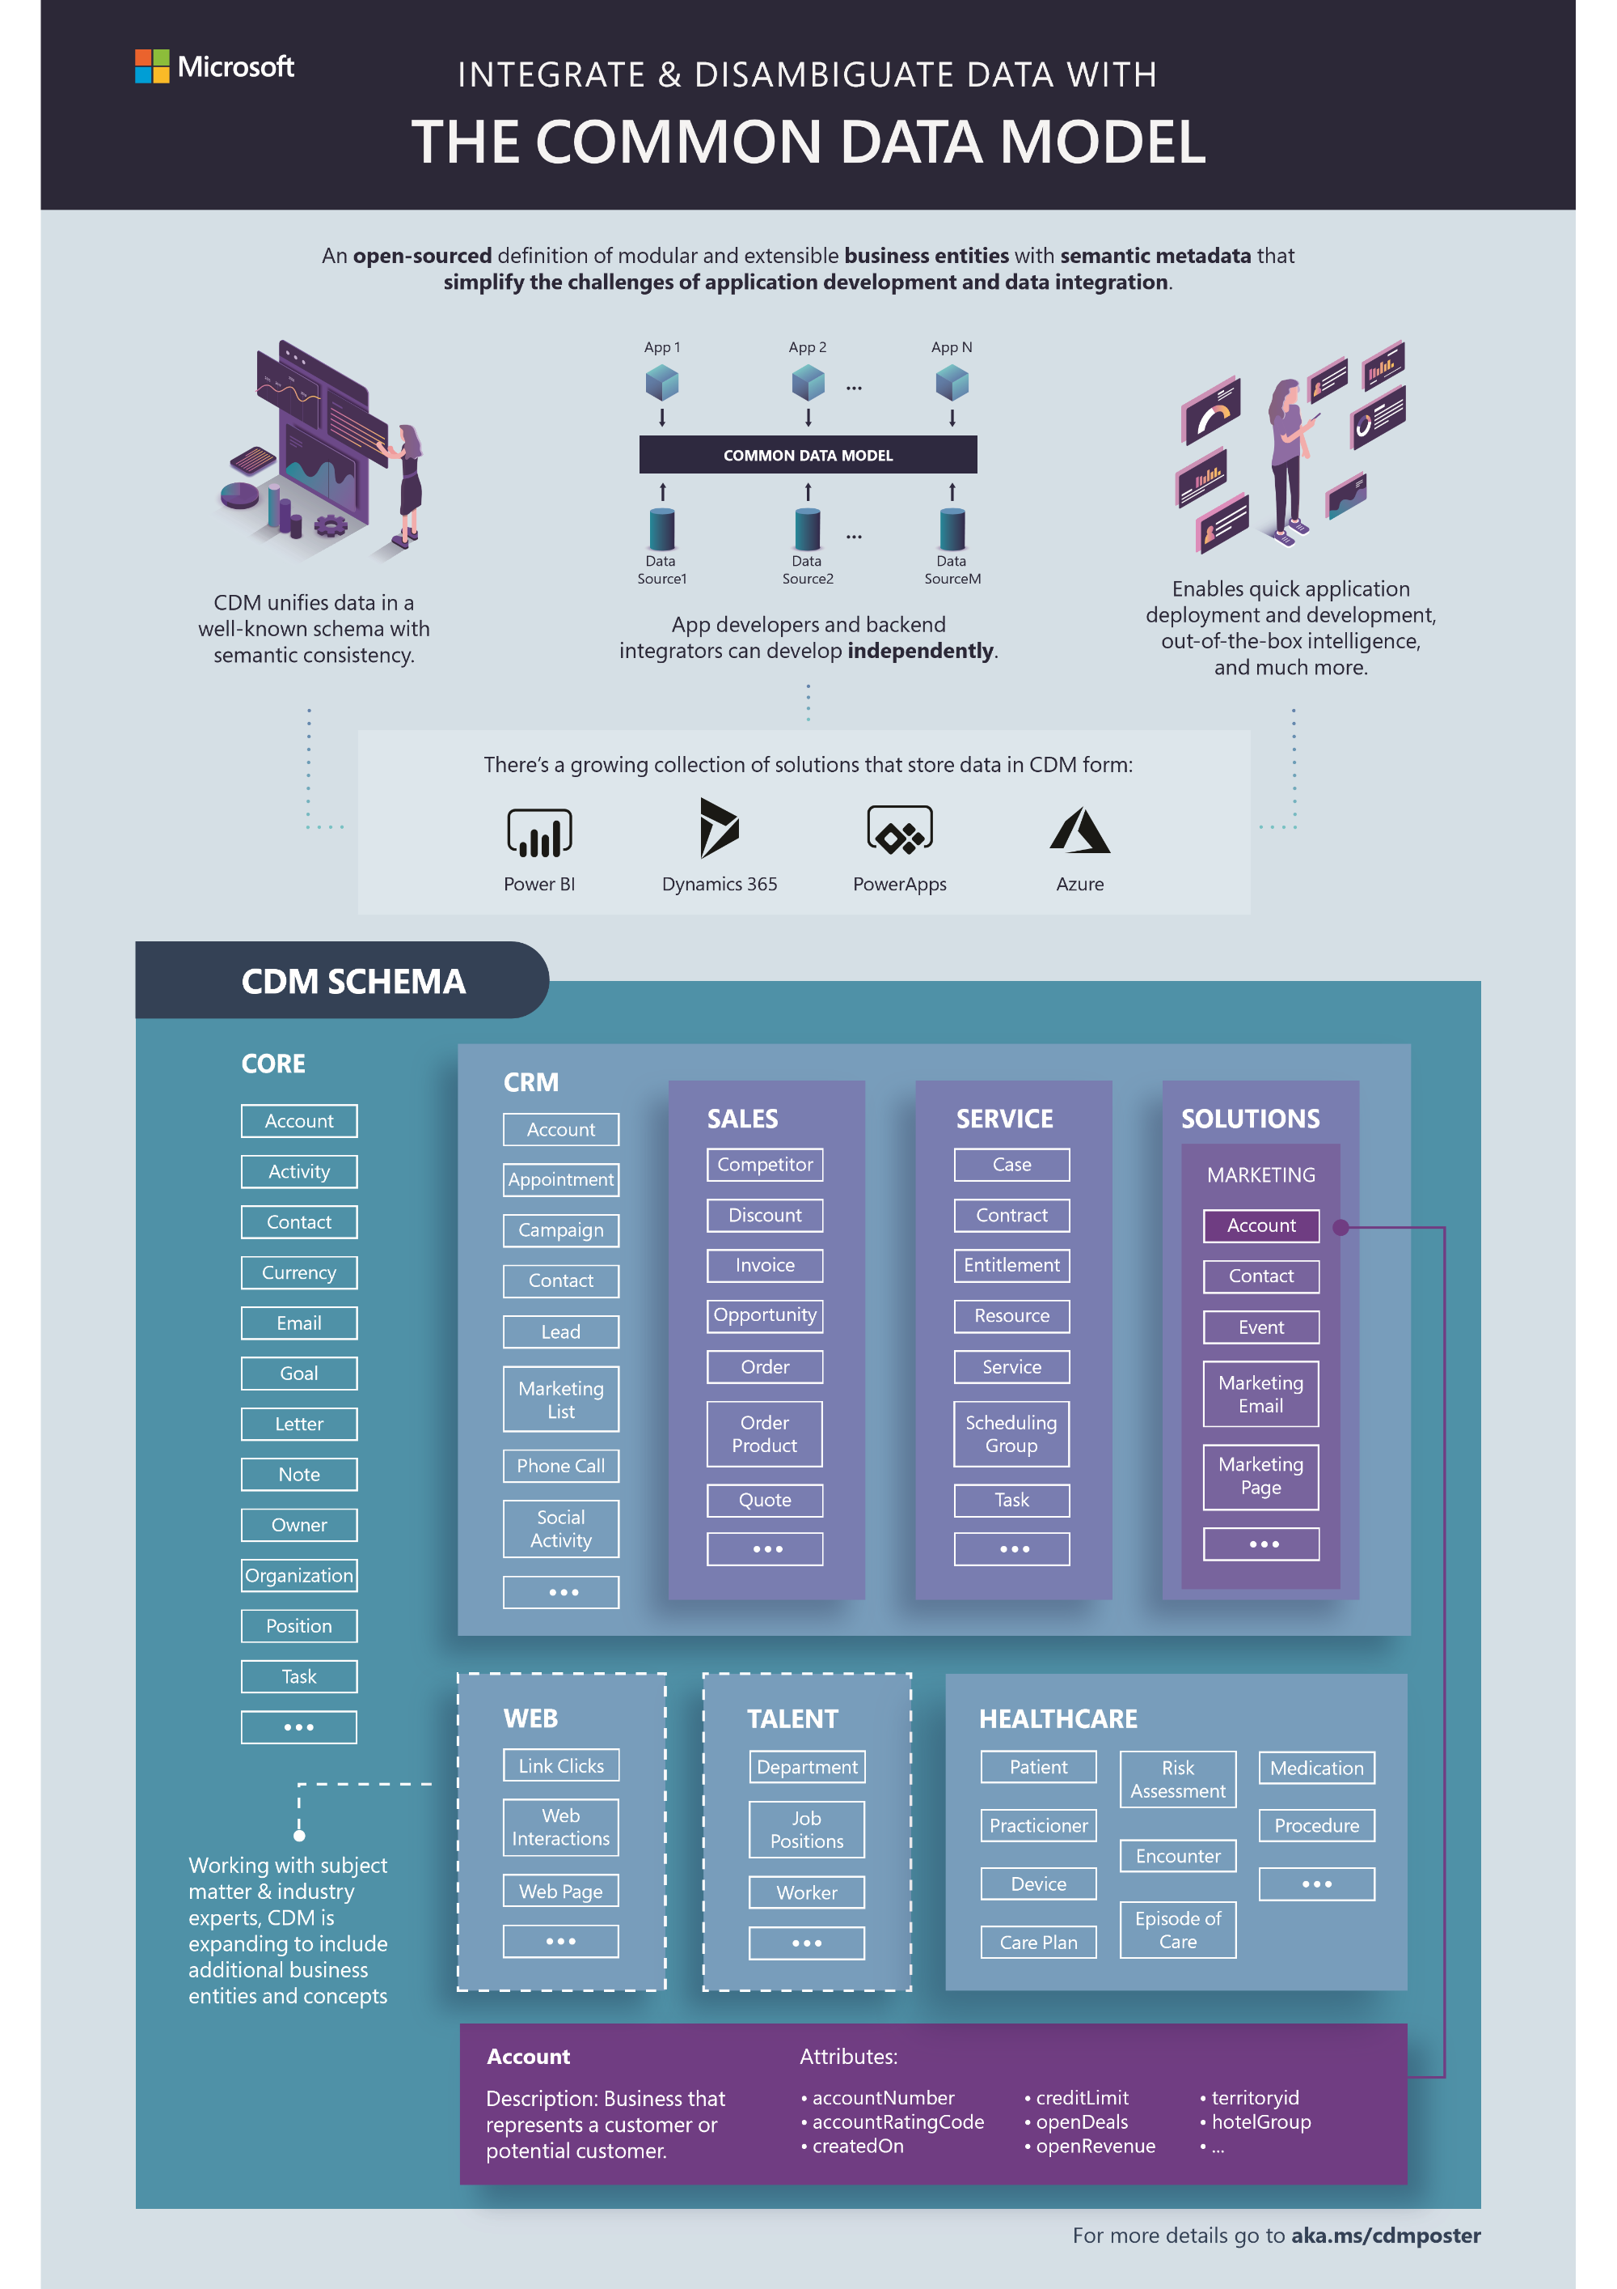
Common Data Model overview
In support of Microsoft's Open Data Initiative, we now have a Common Data Model comprised of an extensible collection of schemas representing common business concepts.
Consuming the Common Data Model
The Common Data Model is maintained in GitHub. Schemas are maintained as json files.
Notes:
In support of Microsoft's Open Data Initiative, we now have a Common Data Model comprised of an extensible collection of schemas representing common business concepts. By using a common schema across all business applications such as Contacts, Leads, Accounts, or Products, data interoperability is greatly simplified.
The following infographic effectively represents the provided current state of the base Common Data Model schemas. This is an evolving ecosystem, and numerous others will surface as time progresses.
The Common Data Model is maintained in GitHub. Schemas are maintained as json files. An entire entity reference can be found on Microsoft Docs. Microsoft also provides a Visual Entity Navigator that allows users to visually navigate Common Data Model entities.
When building against the Common Data Model, you need to understand the layering approach that is taken to building out your custom application's schema. At the base of a Common Data Model application resides a core schema that contains commonly used entities such as Account and Contact. From there, you can layer function or industry-specific models to further accelerate the development of your own custom application, after which you can build your own models. We recommend that if you have a common scenario upon which data reuse is valuable, you should join the Open Data Initiative and begin contributing to the Common Data Model as well.

Slide 10
Overview of Azure solutions and AI applications for Power Apps developers
Cognitive Services
Azure Bot Service
Azure Data Lake Storage
Azure Functions
Service Bus
Event Grid
Logic Apps
Azure SQL Database
Customer Insights
Customer Service Insights
Sales Insights
Notes:
Azure solutions overview
The Azure ecosystem provides a wealth of functionality and enables Power Apps developers to harness its capabilities through various extensibility points. This unit reviews a few Azure solutions in the context of how they play, or potentially play, a role in a model-driven PowerApp. Azure offers many other solutions; therefore, all PowerApp developers should familiarize themselves with all that Azure has to offer
Cognitive Services
Azure Cognitive Services includes APIs, SDKs, and services that are available to help developers add cognitive features to their applications. The Power Platform's extensibility framework makes it possible for users to incorporate these features into a PowerApp. The catalog of services within Azure Cognitive Services can be categorized into five main pillars: Vision, Speech, Language, Web Search, and Decision.
Azure Bot Service
Azure Bot Service provides a framework in which you can build, test, deploy, and manage intelligent bots all in one place. Frequently, bots come into play with customer self-service, a common scenario in the Dynamics 365 for Customer Service application. Many other applications of Azure Bot Service are available, where you can shift simple, repetitive tasks such as gathering profile information into an interactive question and answer framework
Azure Data Lake Storage
Power Platform data seamlessly supports Azure Data Lake storage with its Common Data Service and Common Data Model framework. Building on top of the Power Platform enables you to empower complex analytics scenarios to use industrialized big data tools such as Power BI or Azure HDInsight.
Azure Functions
Azure Functions is a supported extensibility endpoint for model-driven Power Apps. Extracting custom logic into an Azure function enables you to offload complex logic outside of your transactional application, thus providing a much more stable and effective user experience.
Service Bus
Azure Service Bus is a reliable messaging-as-a-service (MaaS) framework that enables real-time, asynchronous messaging across systems. In specific use cases, this is a valuable feature that provides the ability to integrate with both cloud and on-premise systems in a serverless, distributed fashion.
Event Grid
Event Grid is a fully-managed event routing service.
Logic Apps
Logic Apps is quickly becoming the preferred method for orchestrating integrations across the Power Platform.
Azure SQL Database
Common Data Service provides the ability to configure near-real-time synchronization of data into an Azure SQL database by using Data Export Service.
Dynamics 365 AI applications
Dynamics 365 provides several first-party AI applications that are worth mentioning. Among these are Customer Insights, Market Insights, AI for Sales, and AI for Customer Service Insights. The Market Insights application is currently in preview and will therefore not be covered in detail at this point.
Customer Insights
Customer Insights is a valuable framework that enables organizations to connect to data from various transactional, behavioral, and observational sources to create a 360-degree customer view. It integrates with data sources, such as Microsoft Graph, to enable for richer customer profiles, and supports embedding of customer insights within line-of-business applications that are built on the Microsoft Power Platform.
Customer Service Insights
Dynamics 365 Customer Service Insights is an AI application that provides utility to a customer service organization by providing AI-driven technology for in-depth case analysis. It automatically groups cases into topics by using natural language understanding, which allows you to make informed decisions about how to improve customer service experiences. Additionally, it integrates with a variety of data sources and allows you to map custom fields into the application that might be used to drive the Customer Service Insights' machine learning models.
Sales Insights
Dynamics 365 Sales Insights has two main components as part of its application:
Dynamics 365 Sales Insights capabilities for sellers
Dynamics 365 Sales Insights capabilities for sales managers
Dynamics 365 Sales Insights capabilities for sellers consists of the following features:
Relationship analytics - Gathers relevant information from throughout the Dynamics 365 for Sales database to create a graphical display of key performance indicators (KPIs) and activity histories. For more information, see Use Relationship analytics to gather KPIs.
Predictive lead scoring - Helps you focus on revenue generation efforts by providing scores so you can prioritize efforts on quality leads. For more information, see Work with Predictive lead scoring..
Predictive opportunity scoring - Helps you focus on revenue generation efforts by providing scores so you can prioritize efforts on quality opportunities. For more information, see Convert opportunities into deals..
Notes analysis - Monitors notes that you enter regarding a recent meeting or discussion with your customer to provide intelligent suggestions. For more information, see How notes analysis assists you with suggestion.
Talking points - Displays topics to start a conversation with your customer such as sports, vacation, family, and entertainment. For more information, see Know conversation starters for your customers.
Who knows whom - Provides details such as names and email addresses of your colleagues who know a lead with whom you are going to interact. For more information, see How to get introduced to a lead.

Slide 11
Explore the Power Platform Developer Guide
A wealth of assets is available that developers can review to better acquaint themselves on developing against the Common Data Service framework.
Sample code
Useful links
Notes:
A wealth of assets is available that developers can review to better acquaint themselves on developing against the Common Data Service framework. Some of these are legacy assets that are branded as Dynamics 365 SDK documentation. Common Data Service is an evolution of the Dynamics 365 platform. Many of the existing materials surrounding how to extend the platform still apply. While these materials can be great resources, they're no longer current; therefore, use them with discretion.
Microsoft also provides a large amount of sample code that shows you a host of activities that you would commonly perform as a Common Data Service developer. These activities include interacting with the Web API or Organization Service, and also how to take advantage of a useful collection of assemblies called XrmTooling for accelerating common actions such as authentication against the Common Data Service by means of third-party applications. These codes can be found in GitHub and in various other mechanisms, such as through NuGet packages. You can find links to these in the following section.
The following are links that should be added as favorites to any Power Apps developer's repository.
Common Data Service Developer Guide
Model-driven App Developer Guide
Power Apps Developer Documentation
Common Data Service Sample and Helper Code
Microsoft Power Apps NuGet Packages

Slide 12
Use developer tools to extend the Power Platform

Slide 13
Microsoft NuGet tools
Microsoft provides a variety of tools to help support development against Common Data Service, which are available through NuGet packages.
Code Generation Tool
Configuration Migration Tool
Package Deployer
Plugin Registration Tool
Solution Packager Tool
Notes:
Code Generation ToolCrmSvcUtil.exe Microsoft.CrmSdk.CoreTools Generates early-bound .NET Framework classes that represent the entity data model that is used by model-driven apps.
Configuration Migration ToolDataMigrationUtility.exe Microsoft.CrmSdk.XrmTooling.ConfigurationMigration.Wpf Tool that is used to move configuration data across CDS instances.
Package DeployerPackageDeployer.exe Microsoft.CrmSdk.XrmTooling.PackageDeployment.WPF Tool that enables administrators to deploy packages on a CDS instance.
Plugin Registration ToolPluginRegistration.exeMicrosoft.CrmSdk.XrmTooling.PluginRegistrationTool Tool that is used to register plug-ins against a CDS instance.
Solution Packager ToolSolutionPackager.exeMicrosoft.CrmSdk.CoreTools Tool that reversibly decomposes CDS solutions into multiple XML files to be managed by a source control system.

Slide 14
XrmToolbox Tools
There are a number of community developer tools available from XrmToolBox . A few of the tools are listed below.
WebResources Manager
Tool to install, update, delete, and preview web resources in a Model-driven app.
FetchXML Builder
Provides a UI to compose FetchXML queries and query information that is not easily found within the PowerApp user interface, and converts FetchXML into C# QueryExpression methods and OData query strings.
View Layout Replicator
Copy and apply the layout of a particular view to multiple views of the same entity.
View Designer
Tool to modify View queries that use FetchXML builder.
Early Bound Generator
Generate early-bound entities, option sets, and actions. Uses CrmSvcUtil.exe
Notes:
WebResources ManagerTool to install, update, delete, and preview web resources in a Model-driven app.
FetchXML BuilderProvides a UI to compose FetchXML queries and query information that is not easily found within the PowerApp user interface, and converts FetchXML into C# QueryExpression methods and OData query strings.View
Layout ReplicatorCopy and apply the layout of a particular view to multiple views of the same entity.
View DesignerTool to modify View queries that use FetchXML builder.
Early Bound GeneratorGenerate early-bound entities, option sets, and actions. Uses CrmSvcUtil.exe .

Slide 15
XrmToolbox Tools
There are a number of community developer tools available from XrmToolBox . A few of the tools are listed below.
Metadata Browser
Browse metadata that is contained within your CDS instance.
Plugin Trace Viewer
Easy-to-use tool to filter and display information within a Plug-in Trace Log.
Export to Microsoft Excel
Export records from a view or FetchXML query to Microsoft Excel.
Attribute Manager
Rename/delete/change the type of an attribute.
Iconator
Manage custom entity icons in a single screen.
Notes:
Metadata BrowserBrowse metadata that is contained within your Dataverse instance.
Plugin Trace ViewerEasy-to-use tool to filter and display information within a Plug-in Trace Log.
Export to Microsoft ExcelExport records from a view or FetchXML query to Microsoft Excel.
Attribute ManagerRename/delete/change the type of an attribute.
IconatorManage custom entity icons in a single screen.
Easy TranslatorExport/import translations with contextual information.
Auto Number ManagerUI to set, update, and remove autonumber formatting on new or existing attributes.

Slide 16
Deploy apps with Package Deployer
Package Deployer overview
Configuring a Package Deployer package
Notes:
Package Deployer overview
Package Deployer is a solution built by Microsoft that gives administrators the ability to deploy packages of solutions and data across environments. Data can be represented as flat files (in other words, csv files) or exported data from the Configuration Migration tool. You can also write custom code to run before, during, or after a package is deployed to a Microsoft Dataverse app instance.
Configuring a Package Deployer package
The most complex element of creating a Package Deployer package is configuring its settings. These settings are maintained in an XML file (ImportConfig.xml, specifically) and can be grouped into a few main elements.

Slide 17
configdatastorage Attributes
The main settings of a Package Deployer package are found at the configdatastorage root node of the ImportConfig.xml document. The following table shows the settings that are available for you to configure.
installsampledata | If set to true, installs sample data to the Dataverse instance.
waitforsampledatatoinstall | If true, and installsampledata is also true, waits for sample data to install before deploying the package.
agentdesktopzipfile | Commonly used for creating Unified Service Desk packages. For more information about Unified Service Desk, see Administration Guide for Unified Service Desk 3.0 .
agentedesktopexename | Commonly used for creating Unified Service Desk packages. For more information about Unified Service Desk, see Administration Guide for Unified Service Desk 3.0 .
crmmigdataimportfile | File name of the default configuration data file (.zip) that is exported by using the Configuration Migration tool. For more information on the Configuration Migration tool, see Move configuration data across instances and organizations with the Configuration Migration tool .

Slide 18
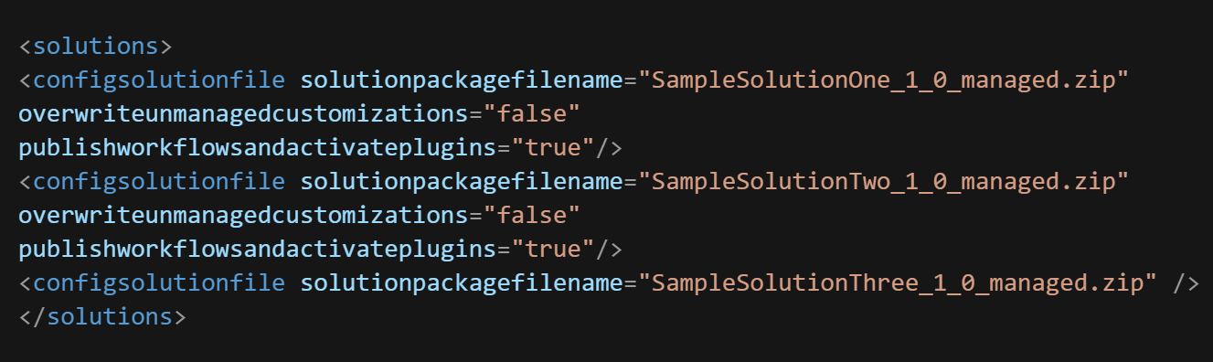
<solutions> Node
Attribute | Description
solutionpackagefilename | Specifies .zip file name of the given solution
overwriteunmanagedcustomization | Specifies whether to overwrite any unmanaged customizations when you are importing a solution that already exists in the target Dataverse instance.
publishworkflowsandactivateplugins | Specifies whether to publish workflows and activate plug-ins in the target model-driven app instance after the solution is imported.
Notes:
The <solutions> node contains an array of <configsolutionfile> nodes that describe the solutions to import. The order of the solutions under this node indicates the order in which the solutions will be imported on the target model-driven app instance.

Slide 19
<filestoimport> Node
<configimportfile> nodes can contain the attributes that are outlined in the following table.
Attribute | Description
filename | Name of the file that contains the import data. If the file is a .zip file, a node must be present with a node for each file in the .zip file.
filetype | This can be csv, xml, or zip.
associatedmap | The name of the import data map to use with this file. If blank, the import process will attempt to use the system-determined import data map for the file that is being imported.
importtoentity | The destination entity to which this file should be imported.
datadelimiter | The name of the data delimiter that is used in the import file. Valid values are single quote or double quotes.
fielddelimiter | The name of the field delimiter that is used in the import file. Valid values are comma, colon, or single quote.
enableduplicatedetection | Indicates whether to enable duplicate detection rules on the data import. Valid values are true or false.
isfirstrowheader | Used to denote that the first row of the import file contains the field names. Valid values are true or false.
isrecordownerateam | Indicates whether the owner of the record on import should be a team. Valid values are true or false.
owneruser | Indicates the user ID that should own the records. The default value is the user who is currently logged in.
waitforimporttocomplete | If true, the system waits for the import to complete before proceeding. If false, it queues the jobs and moves on.
Notes:
The <filestoimport> node contains an array of <configimportfile> and <zipimportdetails> nodes that are used to describe individual files and zip files, respectively, to be imported

Slide 20
<filestoimport> Node
<zipimportdetails> nodes can contain the attributes that are shown in the following table.
Attribute | Description
filename | Name of the file that contains the import data.
filetype | This can be csv or xml.
importtoentity | The destination entity to which this file should be imported.

Slide 21
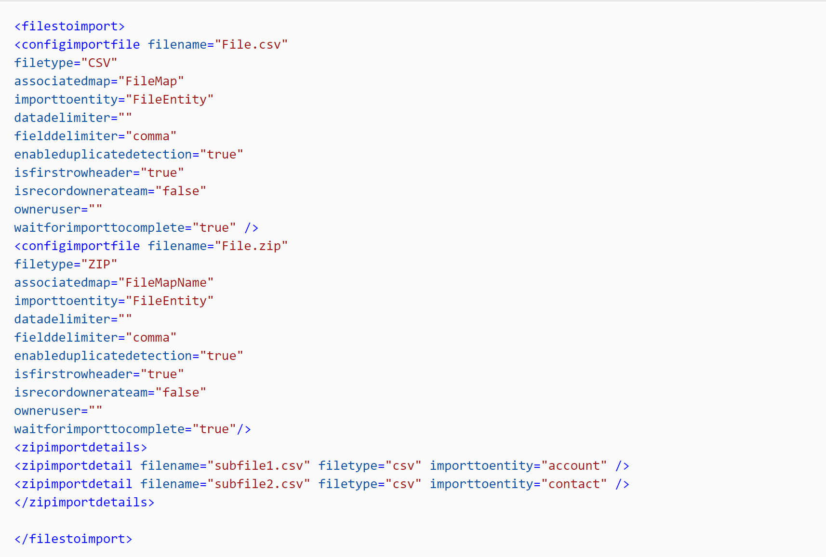
<filestoimport> Node
<zipimportdetails> nodes can contain the attributes that are shown in the following table.
Notes:
The <filestoimport> node contains an array of <configimportfile> and <zipimportdetails> nodes that are used to describe individual files and zip files, respectively, to be imported.

Slide 22
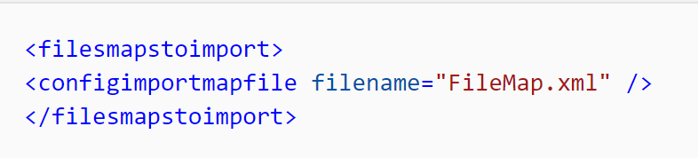
<filemapstoimport> Node
The <filemapstoimport> node contains an array of <configmapimportfile> nodes to import. The order of the map files in this node indicates the order in which they are imported.

Slide 23
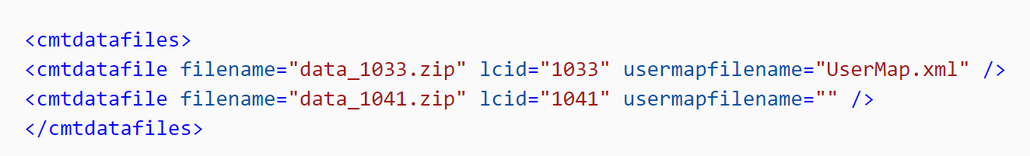
<crmdatafiles> Node
The <crmdatafiles> node contains an array of <cmtdatafile> nodes that contain localized versions of the configuration data files to be imported. You can also define custom logic to import a localized configuration data file instead of the default one that is specified in the crmmigdataimportfile.

Slide 24
Steps to create a Package Deployer package

Slide 25
Manage solutions with Solution Packager
SolutionPackager tool overview
Extract: Extract solution .zip file to a folder
Pack: Pack a folder into a .zip file
Extraction-based actions
Argument | Description
/allowWrite{Yes|No} | Optional. Default value is Yes. The /allowWrite:No parameter enables the extract option to be safely assessed without overwriting or deleting any existing files.
/allowDelete{Yes|No|Prompt} | Optional. Default value is Prompt. The /allowDelete:No parameter prevents any existing files within the extracted solution folder from being deleted. If /allowWrite:No is set, no deletes will occur even if /allowDelete:Yes is specified.
/clobber | Optional. When specified, the /clobber flag will overwrite or delete any file that has been set as read only. Clobbering a file is defined as overwriting its contents and is commonly used to clean up unnecessary files.
/sourceLoc: | Optional. This argument generates a template resource file and is valid only on extract. Possible values are auto or an LCID/ISO code for the language that you want to export. When this argument is used, the string resources from the given locale are extracted as a neutral .resx file. If auto or just the long or short form of the switch is specified, the base locale or the solution is used. You can use the short form of the command: /src.
Notes:
The SolutionPackager tool manifests a Microsoft Dataverse solution into a series of XML files. These XML files can be easily managed by a source control system. It's distributed as part of the NuGet package Microsoft.CrmSdk.CoreTools .
The SolutionPackager tool is an executable that you can use to conduct the following actions:
Extract: Extract solution .zip file to a folder
Pack: Pack a folder into a .zip file
It comes with different kinds of command-line arguments that you can use to do specific actions as part of your solution extract/pack operation. For in-depth details on how to use the SolutionPackager tool, see the SolutionPackager Tool article on Microsoft Docs. Additionally, third-party tools are commonly used to simplify the process of extracting and/or packing solutions; these tools can be found on GitHub and NuGet.
The following command-line parameters are available for use with the SolutionPackager executable as it relates to extraction operations.

Slide 26
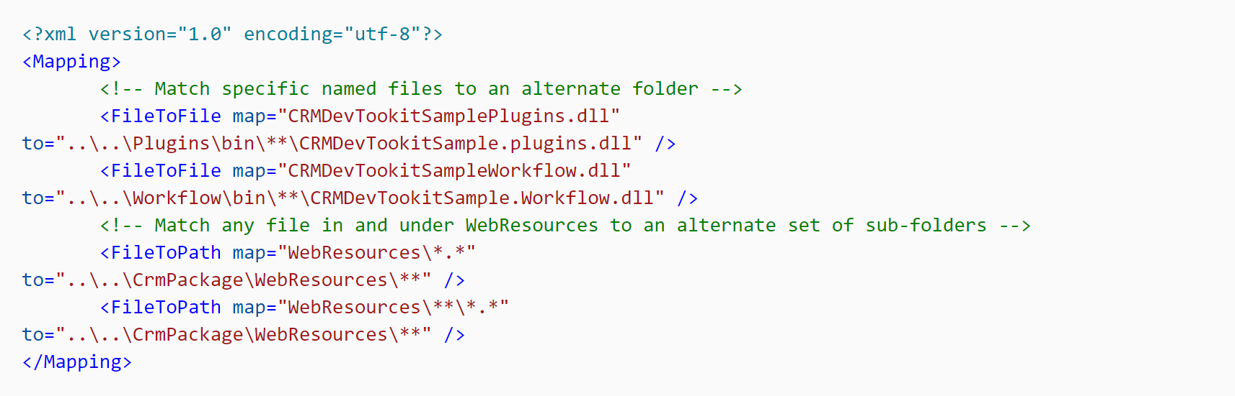
Mapping files not compatible with SolutionPackager
Sometimes it's necessary to manage items, such as web resources, that might require files within a solution to be mapped from their location in the solution zip file to their location in the Package directory.
Notes:
Sometimes it's necessary to manage items, such as web resources, that might require files within a solution to be mapped from their location in the solution zip file to their location in the Package directory. To accomplish this, you can use the /map argument to manage the mapping of these locations. For a detailed explanation on how to build an XML mapping document, see Use the /map Command Argument .
At a high level, you can perform three different types of mapping activities: folder, file-to-file, and file-to-path. For folder mapping, file paths that match the specified map folder will be switched to the destination folder name that is specified in the to parameter. For file-to-file mapping, any file matching the map parameter will be read from the name and path that are specified in the to parameter. For file-to-path mapping, any file matching the map parameter is read from the path that is specified in the to parameter.
The following is a sample mapping:

Slide 27
Exercise: Install a Package Deployer package
Follow the exercise in the student manual
Notes:
https://docs.microsoft.com/en-us/learn/modules/use-developer-tools-extend/4-exercise

Slide 28
Introduction to extending the Microsoft Power Platform
Notes:
This lesson is an add-on for exam coverage purposes

Slide 29
Supported extensibility options
Various supported methods exist for extending a model-driven PowerApp.
Notes:
Various supported methods exist for extending a model-driven PowerApp. The word supported refers to elements that Microsoft has documented as being an approved method for extending business apps and creating client applications that connect to Common Data Service.

Slide 30
Apply business logic by using client script
Client-side scripting is one of the ways to apply custom business process logic for displaying data in a model-driven PowerApp.
Notes:
Client-side scripting is one of the ways to apply custom business process logic for displaying data in a model-driven PowerApp. However, business rules are the preferred method and client script should only be used as a last resort. For more details on client scripting, refer to the Extend the user experience of a model-driven PowerApp learning path.

Slide 31
Build custom UI components
You can use HTML web resources to build custom UI components within a model-driven PowerApp.
Notes:
You can use HTML web resources to build custom UI components within a model-driven PowerApp. The preferred method is to use the Power Apps component framework to achieve this objective.
For more details on building HTML web resources, refer to the Extend the user experience of a model-driven PowerApp learning path.

Slide 32
Extend the Common Data Service platform
You can also extend the Common Data Service platform through other mechanisms such as writing plug-ins or custom workflow activities.
Notes:
You can also extend the Common Data Service platform through other mechanisms such as writing plug-ins or custom workflow activities. For more details on how to develop these types of extensions, see the Extend the Common Data Service platform learning path.

Slide 33
View or edit the app interface by using code (advanced)
Scenarios might occur where you want to use code to automate the customization of a model-driven app's interface.
Notes:
Scenarios might occur where you want to use code to automate the customization of a model-driven app's interface. This could be an approach in certain Azure DevOps or deployment scenarios; however, it is highly uncommon. If you want to view and/or manipulate configuration at this level, we recommend that you use the Solution Packager tool. This tool extracts configuration items into their own XML files and helps make it easier to manage.

Slide 34
Customize entity forms with code
All entity forms are stored in a SystemForm entity.
Notes:
All entity forms are stored in a SystemForm entity. When exporting a solution, you can view the FormXml within the form's definition. For more details, see Customize entity forms.

Slide 35
Customize entity views with code
Entity views are stored in a SavedQuery entity and can be created programmatically.
Notes:
Entity views are stored in a SavedQuery entity and can be created programmatically. You can also define them as XML and import them with an unmanaged solution. Personal views are stored in the UserQuery entity and are owned by individual users. View queries are persisted by using the Common Data Service's standard query language, FetchXML. For more details on FetchXML, see Use FetchXML to construct a query.
For more details on customizing entity views, see Customize entity views.

Slide 36
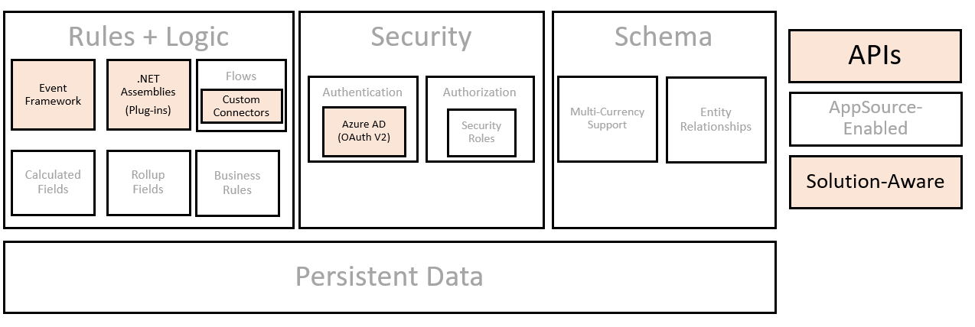
Common Data Service extensibility model
To better understand how to extend Common Data Service, it is valuable to learn about its underlying architecture.
Notes:
To better understand how to extend Common Data Service, it is valuable to learn about its underlying architecture. Because Common Data Service is a software-as-a-service (SaaS) platform, most of these details, such as underlying data storage, are successfully abstracted from developers so they can focus on other tasks such as building custom business logic and integrating with other applications. The following graphic illustrates these underlying components, and the highlighted sections provide a summary of key areas upon which model-driven PowerApp developers should focus.
[!NOTE] This unit is only intended to be a high-level view of the Common Data Service architecture. For more in-depth analysis of Common Data Service, refer to the Common Data Service Developer Guide.

Slide 37
Metadata and solution awareness
At its root, Common Data Service contains two core data models: metadata and application data.
Notes:
At its root, Common Data Service contains two core data models: metadata and application data. Additionally, Common Data Service provides a metadata-driven architecture to provide flexibility for users to create custom entities and extend existing entities. By using this approach, you can then transport your customizations across environments by means of a declarative solution that you can maintain as zip files or extract into XML files when you are using Microsoft's Solution Packager. Solution Packager is the preferred tool to compress and extract a solution file so you can check it into a source control repository. For more details, see Use the Solution Packager tool to compress and extract a solution file.
When you create a custom entity, metadata about that entity, its attributes and relationships to other entities, and user interface components (such as forms and views) are stored as metadata in the system.
Common Data Service also exposes an OData V4 RESTful endpoint, known as the Web API, which can be used to view and manipulate metadata within a Common Data Service instance. One common mechanism for browsing your solution's metadata is the Metadata Browser. Microsoft provides this browser as a solution that you can install into your app. While the current links are found under Dynamics 365 Customer Engagement apps developer documentation, under Microsoft Docs, this tool can be installed into any model-driven PowerApp that is built on Common Data Service. In addition, XrmToolbox has a community metadata browser tool available.

Slide 38
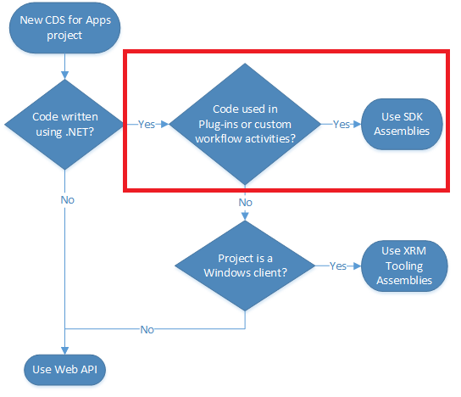
.NET Assemblies (plug-ins)
Plug-ins are managed code classes that are registered to run when specific events occur.
Notes:
Plug-ins are managed code classes that are registered to run when specific events occur. When the event occurs, it passes through a plug-in pipeline that consists of three stages: PreValidation, PreOperation, and PostOperation. When registering a plug-in, you must choose which stage in which your code should run. The stage that you should choose depends on the purpose of the extension. You don't need to apply all your business logic within a single step.
Plug-ins can also be configured to run either synchronously or asynchronously. Synchronous plug-ins run immediately according to the stage and run order, and the entire operation will wait until they complete. Asynchronous plug-ins are run through a system job after the operation completes and can only be registered for the PostOperation stage.
Plug-ins can also be developed and registered as custom workflow activities. Custom workflow activities is a tool that allows developers to produce reusable components that can be used by an administrator to perform actions not provided by the out-of-the-box workflow editor.

Slide 39
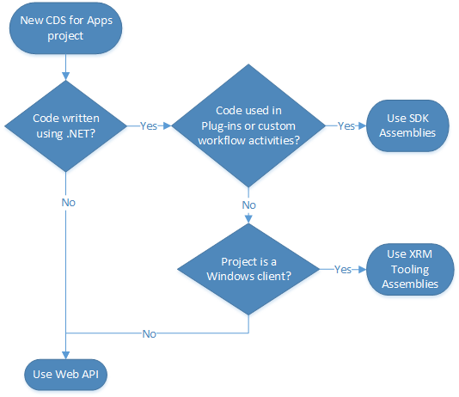
APIs
Web services provide a programmatic interface for applications and services to access business data, organization information, and metadata that is stored in Common Data Service.
Notes:
Web services provide a programmatic interface for applications and services to access business data, organization information, and metadata that is stored in Common Data Service. The main service to access business data is called the Organization Service. Two protocols are available for application code to access this service, each with its own web endpoint: ODATA and SOAP. A RESTful Web API provides access to the ODATA V4 protocol of the web service, while an SDK provides a library of classes and methods to access the SOAP endpoint. The Web API is the more modern and preferred endpoint for new application code, while the SOAP endpoint is more for legacy applications and plug-in and/or custom workflow activity development. Both the Web API and the SOAP endpoints are functionally equivalent, except that the SOAP endpoint must be used for the development of plug-ins and custom workflow activities.

Slide 40
Determine when to configure or when to code
As a best practice, you should approach customizing a model-driven PowerApp from the perspective that writing code is a last-resort method for achieving desired business application functionality.
Notes:
As a best practice, you should approach customizing a model-driven PowerApp from the perspective that writing code is a last-resort method for achieving desired business application functionality. Quality areas such as maintainability, upgradability, stability, and performance should be considered when you are determining what is the best approach for a given scenario.

Slide 41
Business rules vs. client script
At some point, business rules are not able to achieve certain objectives, or maybe the complexity that the rules impose cause developers to prefer writing the logic in client script.
Notes:
At some point, business rules are not able to achieve certain objectives, or maybe the complexity that the rules impose cause developers to prefer writing the logic in client script. One scenario might be if you have a complex "if/then/else" situation that would be better achieved in a switch statement, or if you are dealing with dynamic values that aren't readily accessible by a business rule. For more practical scenarios on when client script is still a preferred and/or required method, refer to the client scripting modules of the Extend the user experience of a model-driven PowerApp learning path. For example, form notifications and filtering out option set values are not available through business rules.

Slide 42
Workflows/flows vs. plug-ins/client script
 | Workflow | Plug-in | Client Script
Synchronous | Either | Either | Synchronous
Access External Data | No | Yes | Yes (with limitations)
Maintenance | Business Users | Developers | Developers
Can Run As | User | Any licensed user, or current user | User
Can Run On Demand | Yes | No | No
Can Nest Child Processes | Yes | Yes | No
Execution Stage | Before/After | Before/After | Before/After
Triggers | Create, Field Change, Status Change, Assign to Owner, On Demand | Create, Field Change, Status Change, Assign to Owner, Delete, along with many other specialized triggers | Field Change or Form Load
In a similar manner as business rules versus client script, certain circumstances might occur upon which limitations might exist that require us to develop plug-ins to accomplish certain activities.
Notes:
In a similar manner as business rules versus client script, certain circumstances might occur upon which limitations might exist that require us to develop plug-ins to accomplish certain activities.
The following table can help you determine when it might be better to use a workflow rather than a plug-in or client script.
Workflow Plug-in Client Script
Synchronous
Either
Either
Synchronous
Access External Data
No
Yes
Yes (with limitations)
Maintenance
Business Users
Developers
Developers
Can Run As
User
Any licensed user, or current user
User
Can Run On Demand
Yes
No
No
Can Nest Child Processes
Yes
Yes
No
Execution Stage
Before/After
Before/After
Before/After
Triggers
Create, Field Change, Status Change, Assign to Owner, On Demand
Create, Field Change, Status Change, Assign to Owner, Delete, along with many other specialized triggers
Field Change or Form Load

Slide 43
Discussion: When to configure vs. when to code
Notes:
Follow the exercise in student handbook and discuss

